Slide 1

Introduction to Operating Systems CS/COE 1550
Spring 2020-2021
Sherif Khattab
ksm73@pitt.edu
(Some slides are from Silberschatz, Galvin and Gagne ©2013)

Slide 2
Announcements
Homework 1 is due this Friday at 11:59 pm
Recitations started last week
Please watch the video
Tophat questions assigned as homework
Lab 1 is due next Friday 6/4 at 11:59 pm
Don’t forget to git add
Using GitHub Classroom
Project 1 will be up this Friday!
A process doesn’t wait() if it has no unwaited-for children!

Slide 3
Last Lecture …
Process scheduling
Process creation and termination

Slide 4
Muddiest Points
zombie and orphan processes
Are zombie/orphan process an issue with all execution methods(parent waits for child, both execute simultaneously, etc)?
Can you go over schedulers again
How schedulers actually work
How swtch records the pc address of the outgoing process. I think I understand now, though: the interrupt leading to the call to swtch saves the user-mode pc to return to, and the kernel-mode interrupt handling saves its own return pc on the stack just as part of calling swtch, as with any other function.
after doing the lab this lecture made the code much easier to understand it was quite confusing trying to trace fork and exit to reinitialize the count datastructure
tracing fork and the wait code
I had trouble tracing the x86 instructions in the swtch function for a context switch in xv6.
Scheduling seems like it can get very confusing very quickly.
Context switching is still confusing for me, but I think I just need to study more.
in the slide "Orphan vs. Zombie Processes", is the zombied P1 adopted by init until P0 exits or am i reading that wrong?
I’ll need more practice tracing code that uses fork()
some tips for the lab
When the wait() system call is passed a parameter (&status) to obtain the exit status of the child process in addition to the child's process id, where is the returned status value? Also, if the child's status isn't terminated, what other status would end the wait of the parent process?

Slide 5
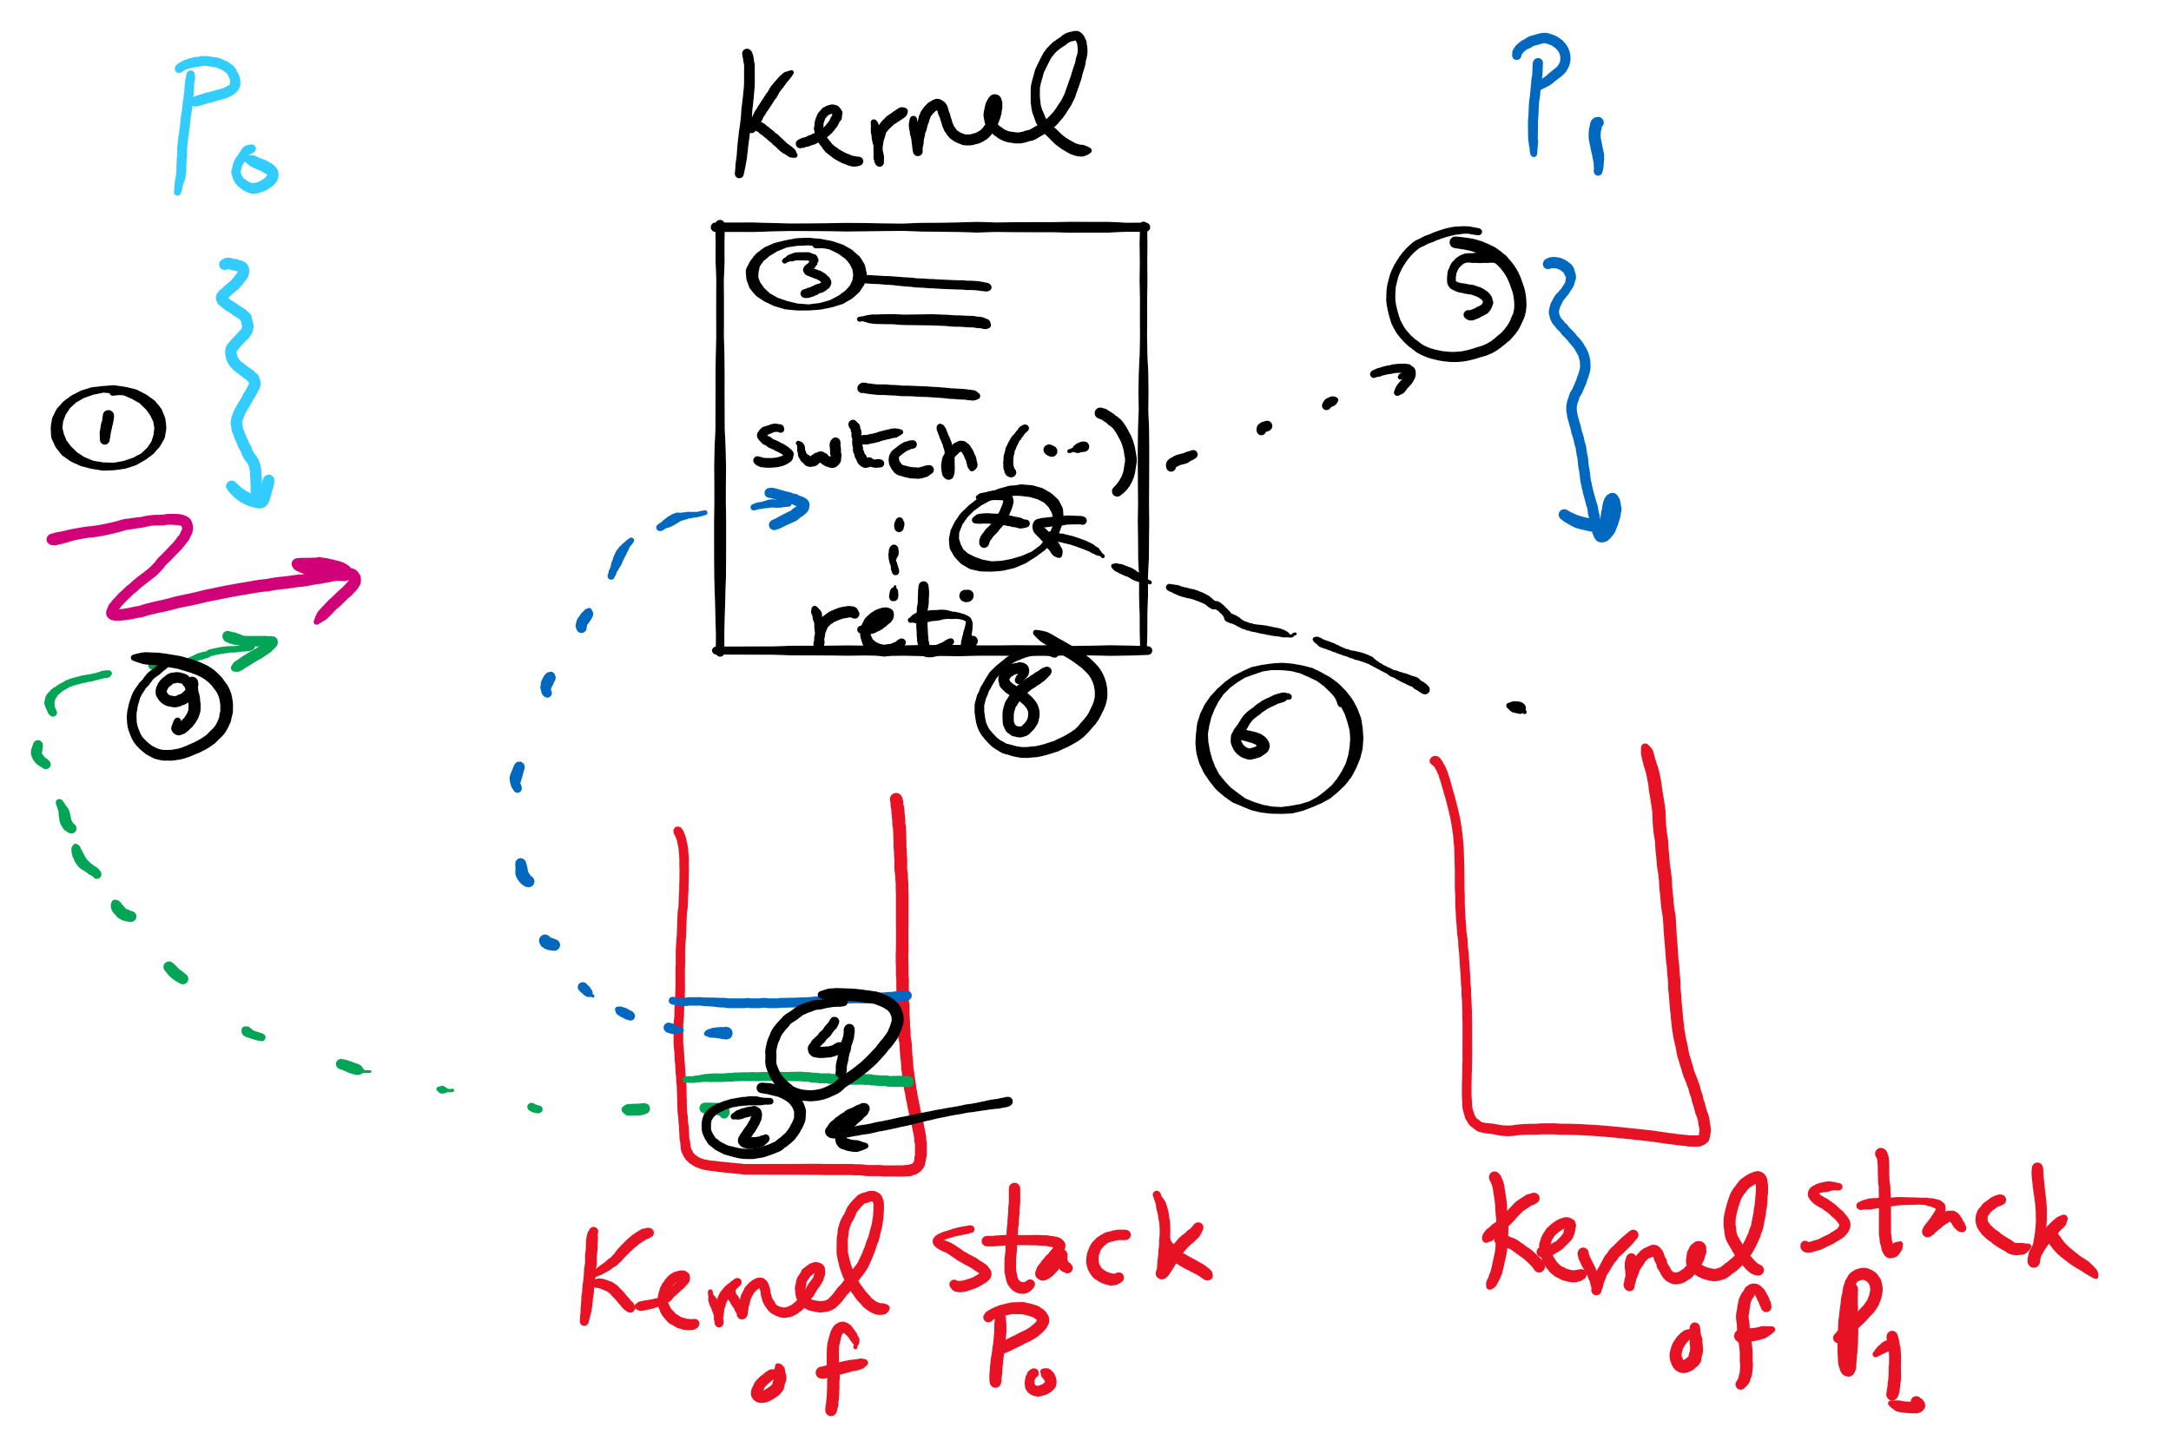
Context Switching

Slide 6
Benefits of Orphan Processes
Allow a long-running job to continue running even after session (e.g., ssh connection) ends.
The nohup command does that
Create deamon processes
Long-running background processes adopted by the init process.

Slide 7
Muddiest Points
Scheduling
Queues
How processes actually get scheduled by the scheduler
How to invoke the schedulers
What is the definition degree of multiprogramming?
What is the difference between the short-term and medium-term schedulers. They seem to both do similar things
How the CPU determines which processes can be safely swapped out without affecting performance.
Moving of registers
fork()
Tracing
IDs of forked processes, and forks of forks
zombie vs orphan
How the parent knows how long to wait when using the wait() syscall
pid for children
exec()
how it works
difference between fork() and exec()
understand the whole process with CODE

Slide 8
Today ….
Spinlocks
How to use
How to implement
Semaphores
How to use
How to implement

Slide 9
Why do we need Synchronization?
Each process operates sequentially
All is fine until processes want to share data
Exchange data between multiple processes
Allow processes to navigate critical regions
Maintain proper sequencing of actions in multiple processes
These issues apply to threads as well
Threads can share data easily (same address space)
Other two issues apply to threads

Slide 10
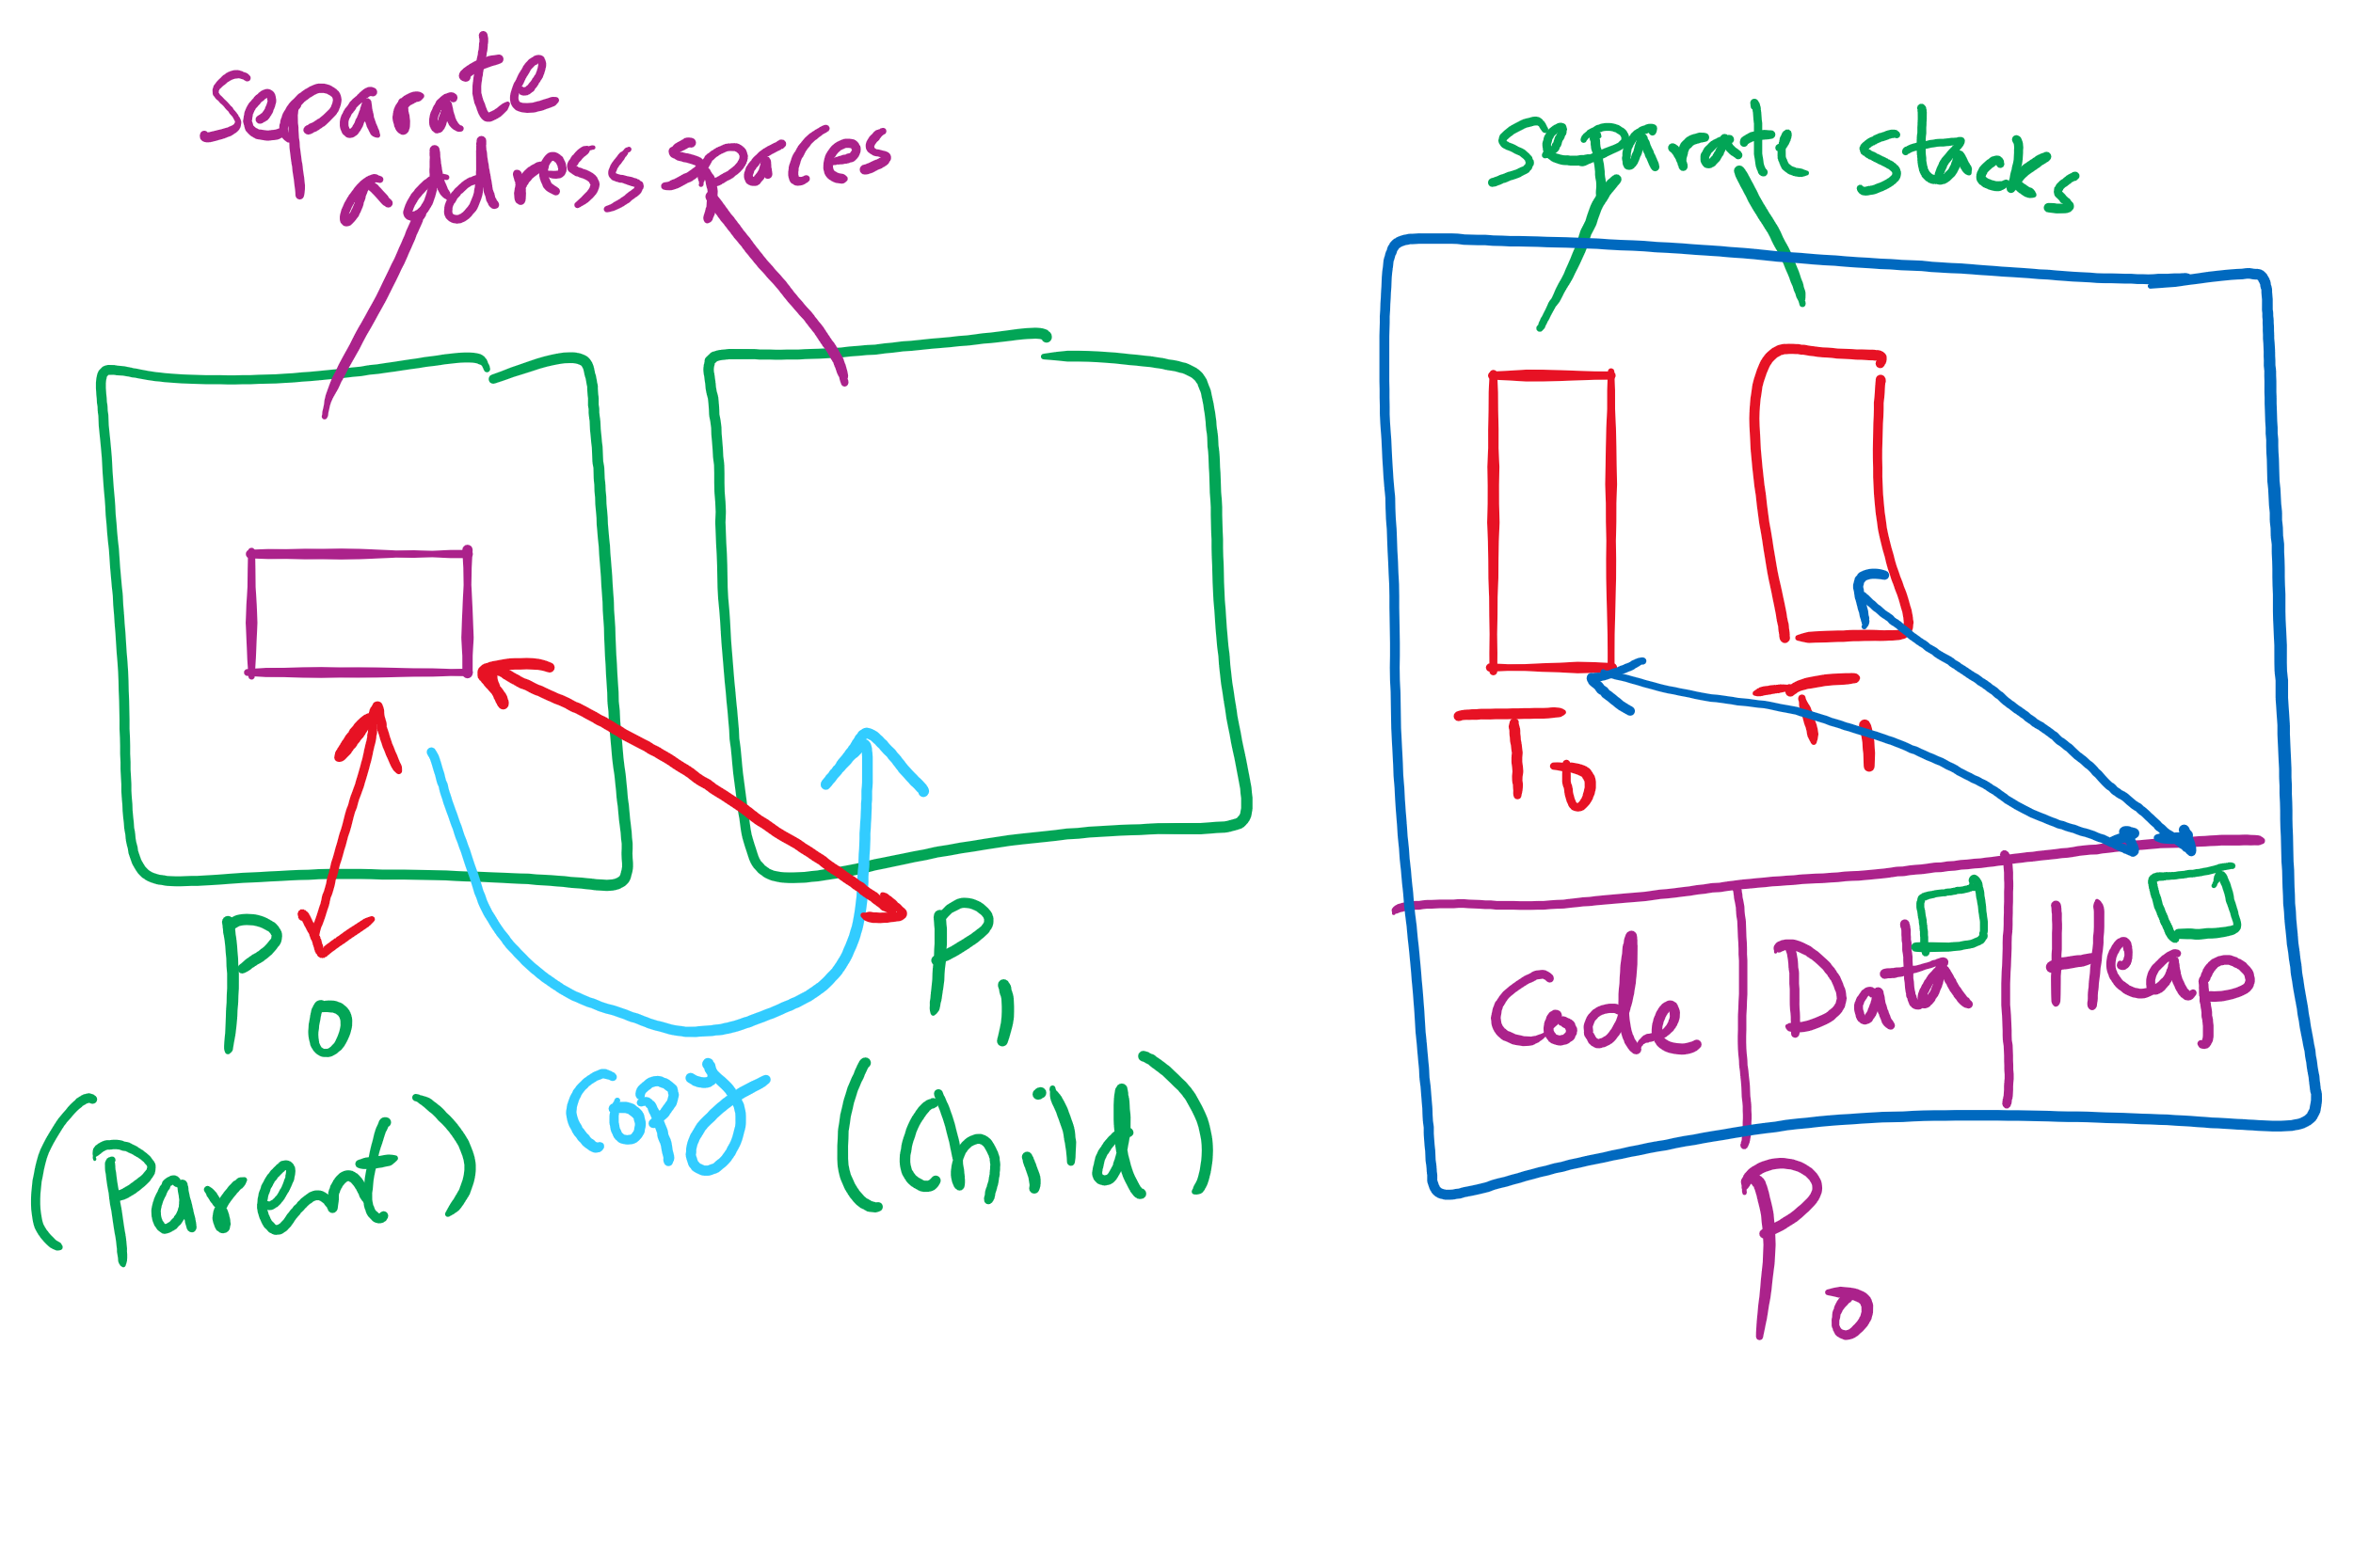
Process vs. Thread

Slide 11
Example: bounded buffer problem
Shared variables const int n; typedef … Item; Item buffer[n]; int in = 0, out = 0, counter = 0;
Atomic statements:
Counter += 1;
Counter -= 1;
Producer
Item pitm; while (1) { … produce an item into pitm … while (counter == n) ; buffer[in] = pitm; in = (in+1) % n;
counter += 1; }
Consumer
Item citm; while (1) { while (counter == 0) ; citm = buffer[out]; out = (out+1) % n;
counter -= 1;
… consume the item in citm … }

Slide 12
Problem: race conditions
Cooperating processes share storage (memory)
Both may read and write the shared memory
Problem: can’t guarantee that read followed by write is atomic
Ordering matters!
This can result in erroneous results!
We need to eliminate race conditions…
P1
P2
x=3
R1 <= x
R1 = R1+1
R1 => x
R3 <= x
R3 = R3+1
R3 => x
x=5
R1 <= x
R3 <= x
R3 = R3+1
R1 = R1+1
R1 => x
R3 => x
x=6!

Slide 13
Critical regions
Use critical regions to provide mutual exclusion and help fix race conditions
Four conditions to provide mutual exclusion
No two processes simultaneously in critical region
No assumptions made about speeds or numbers of CPUs
No process running outside its critical region may block another process
No process must wait forever to enter its critical region
A enters critical region
A leaves critical region
Process A
B enters critical region
B leaves critical region
B tries to enter critical region
Process B
B blocked
Time

Slide 14
Using Spinlocks
Spinlock lock;
Code for process P_{i}
While(1){
Lock(lock)
// critical section
Unlock(lock);
// remainder of code
}
}

Slide 15
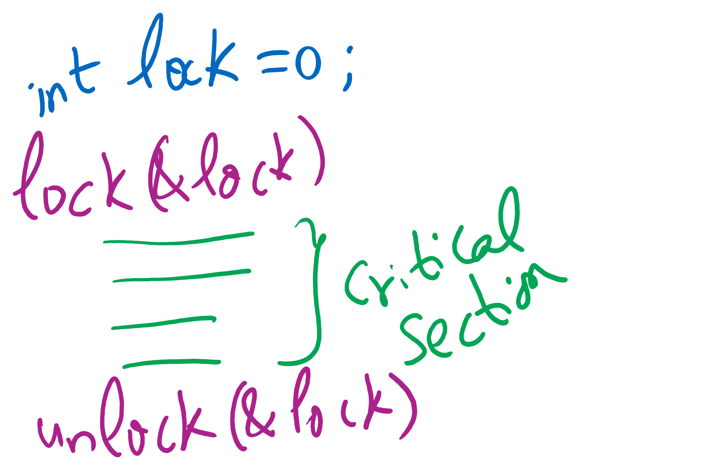
Lock Usage

Slide 16
Spinlock implementation (1/2)
Solution: use hardware
Several hardware methods
Test & set: test a variable and set it in one instruction
Atomic swap: switch register & memory in one instruction
Turn off interrupts: process won’t be switched out unless it asks to be suspended
Test & Set and Atomic Swap can be in user land

Slide 17
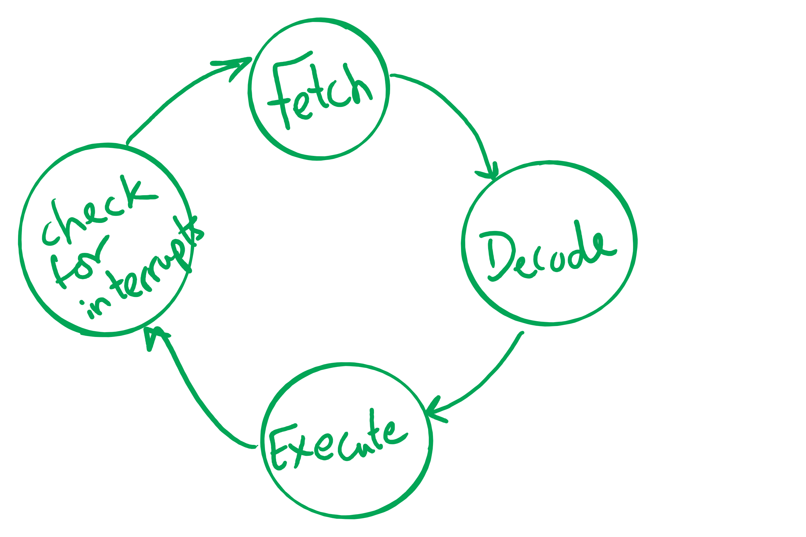
Atomic operations
If done in one instruction, then not interruptible

Slide 18
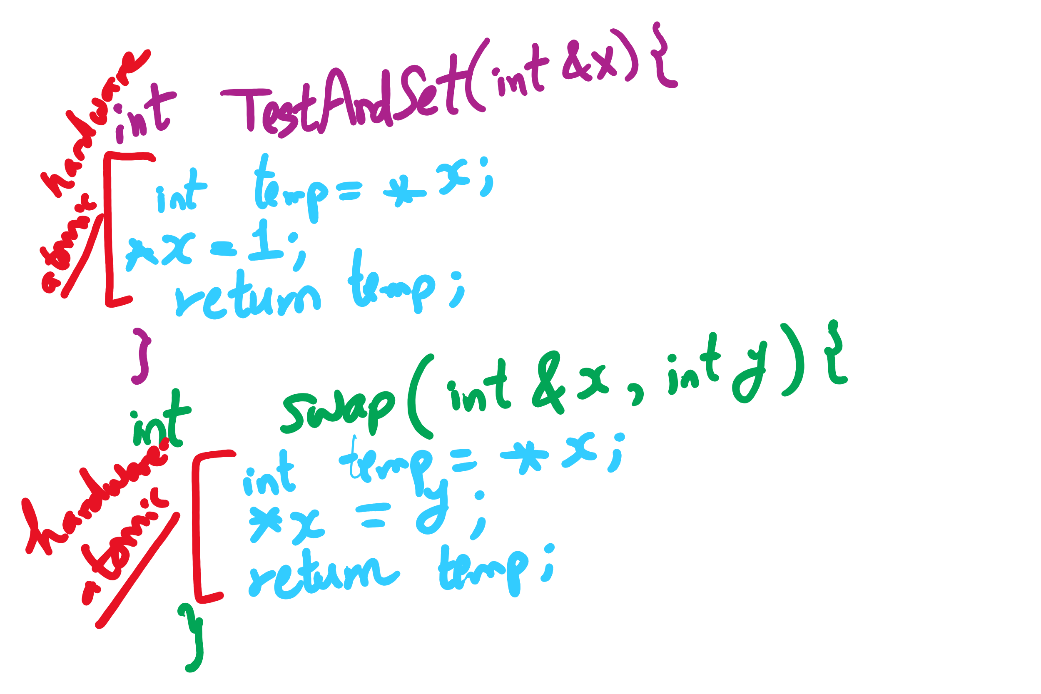
TestAndSet vs. Swap

Slide 19
Spinlock implementation (2/2)
Single shared variable: lock
requires busy waiting, but code is much simple
Two versions
Test and set
Swap
Works for any number of processes
Possible problem with requirements
can lead to unbounded waiting
int lock = 0;
Lock(){
while (TestAndSet(lock))
;
}
Unlock(){
lock = 0;
}
Lock(){
while (Swap(lock,1) == 1)
;
}
Unlock(){
lock = 0;
}

Slide 20
Semaphores
Solution: use semaphores
Synchronization mechanism that doesn’t require busy waiting
Implementation
Semaphore S accessed by two atomic operations
Down(S): while (S<=0) {}; S-= 1;
Up(S): S+=1;
Down() is another name for P()
Up() is another name for V()
Modify implementation to eliminate busy wait from Down()

Slide 21
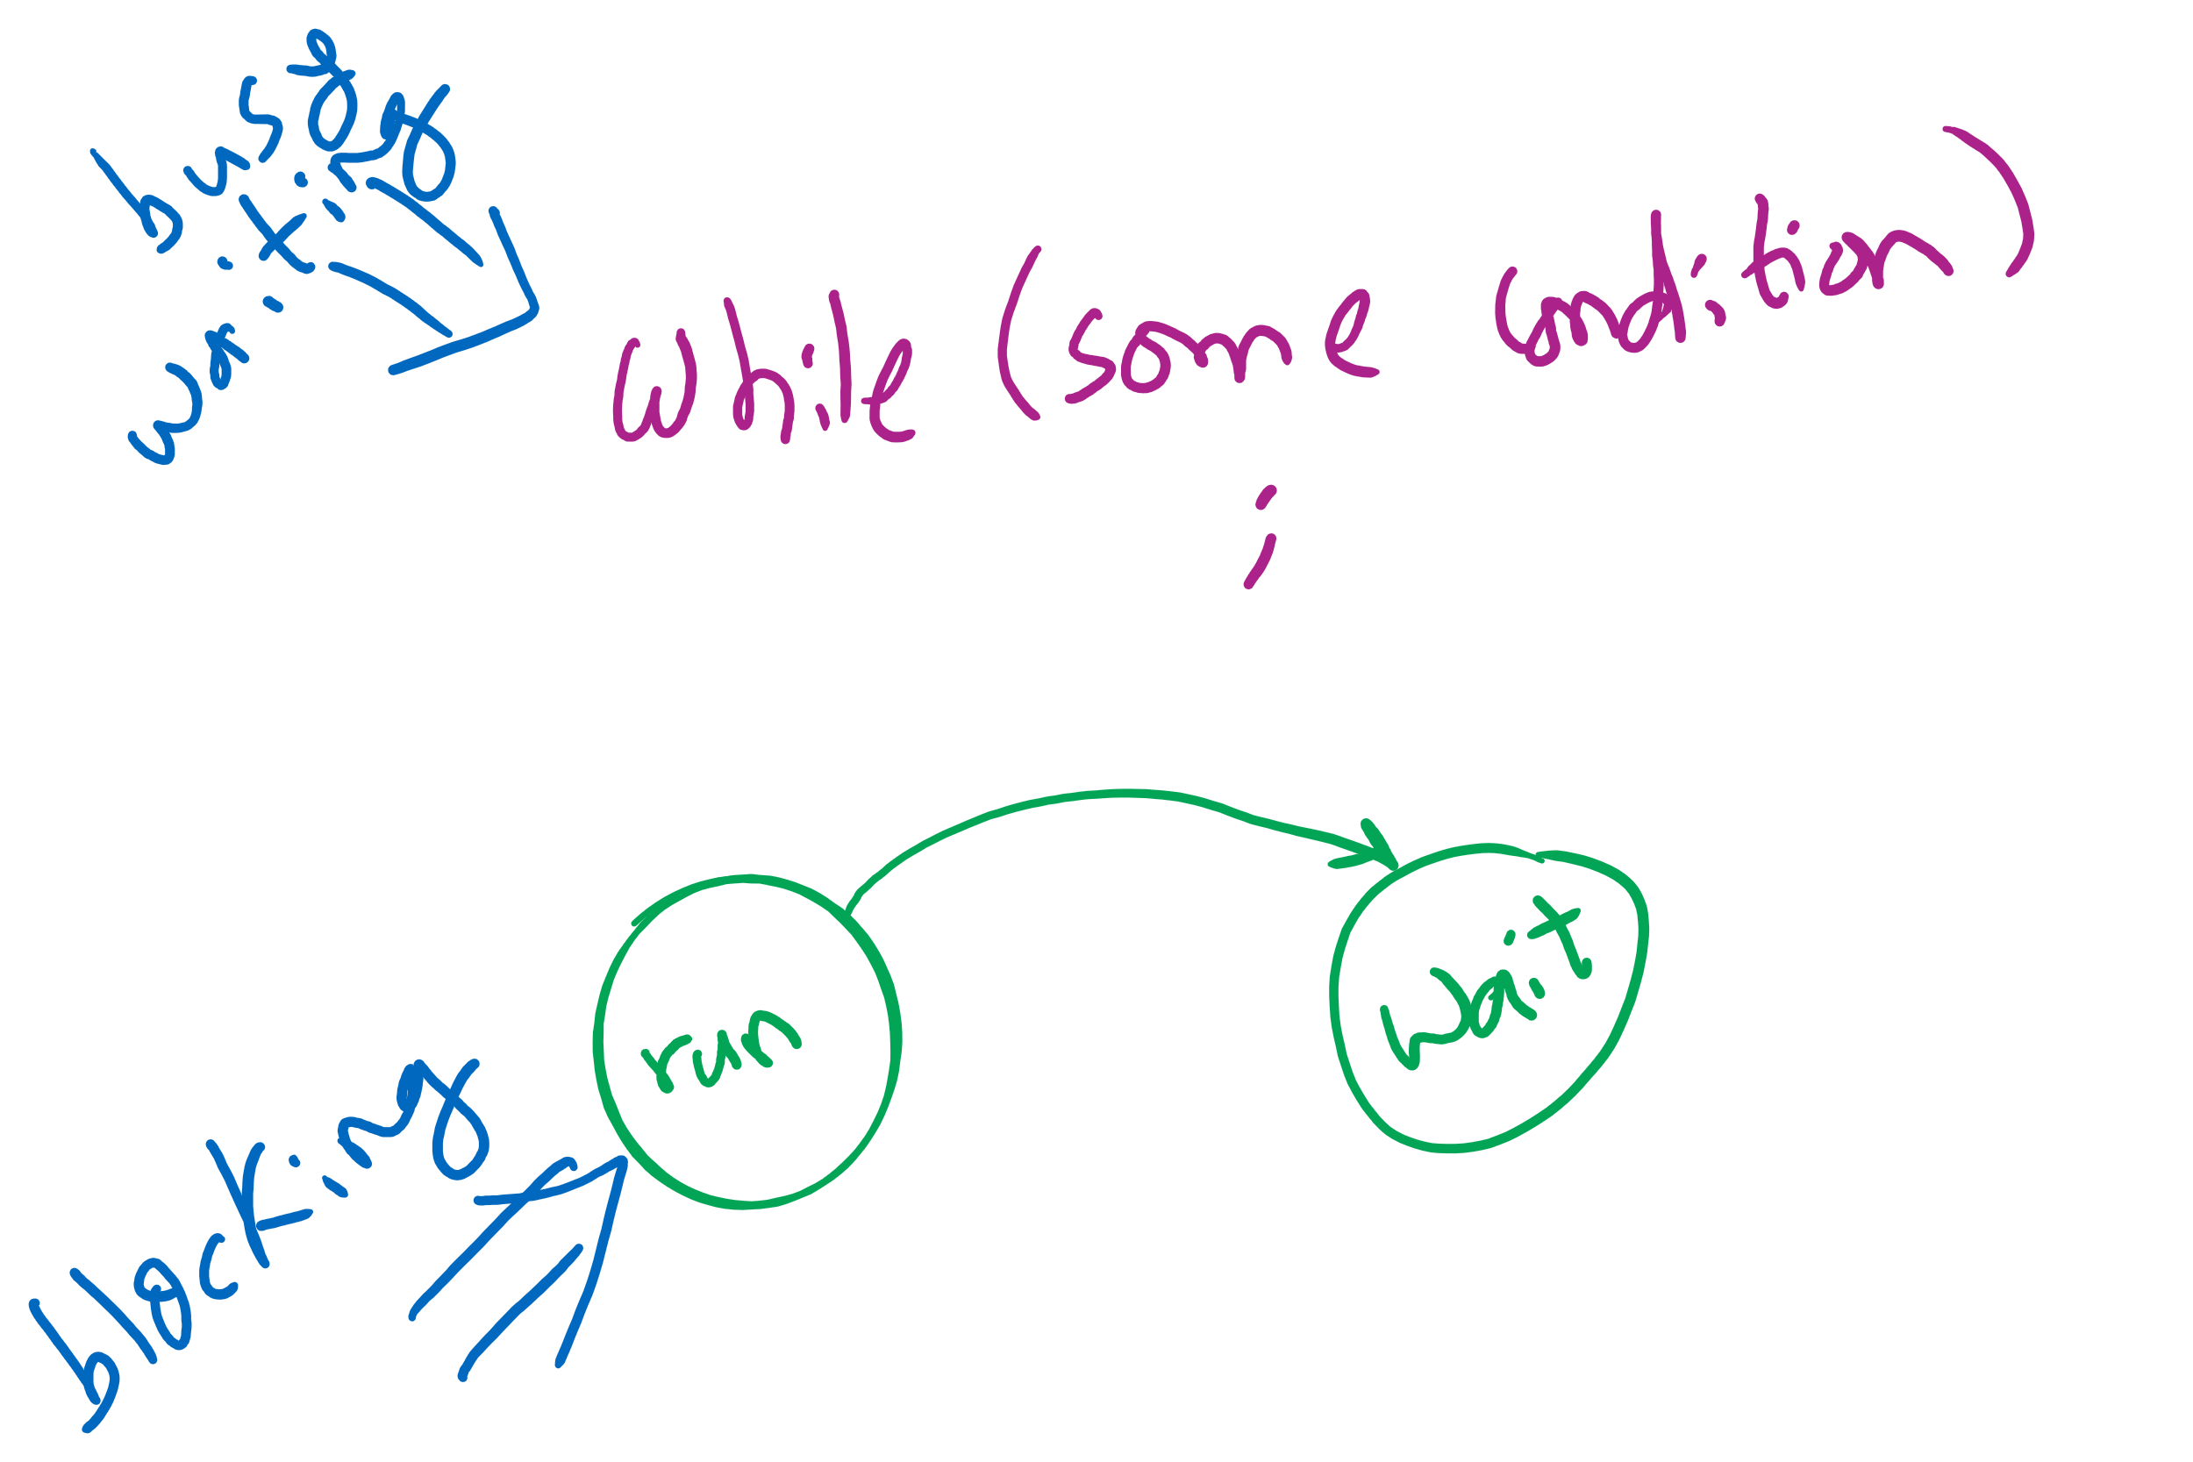
Busy waiting vs. Blocking

Slide 22
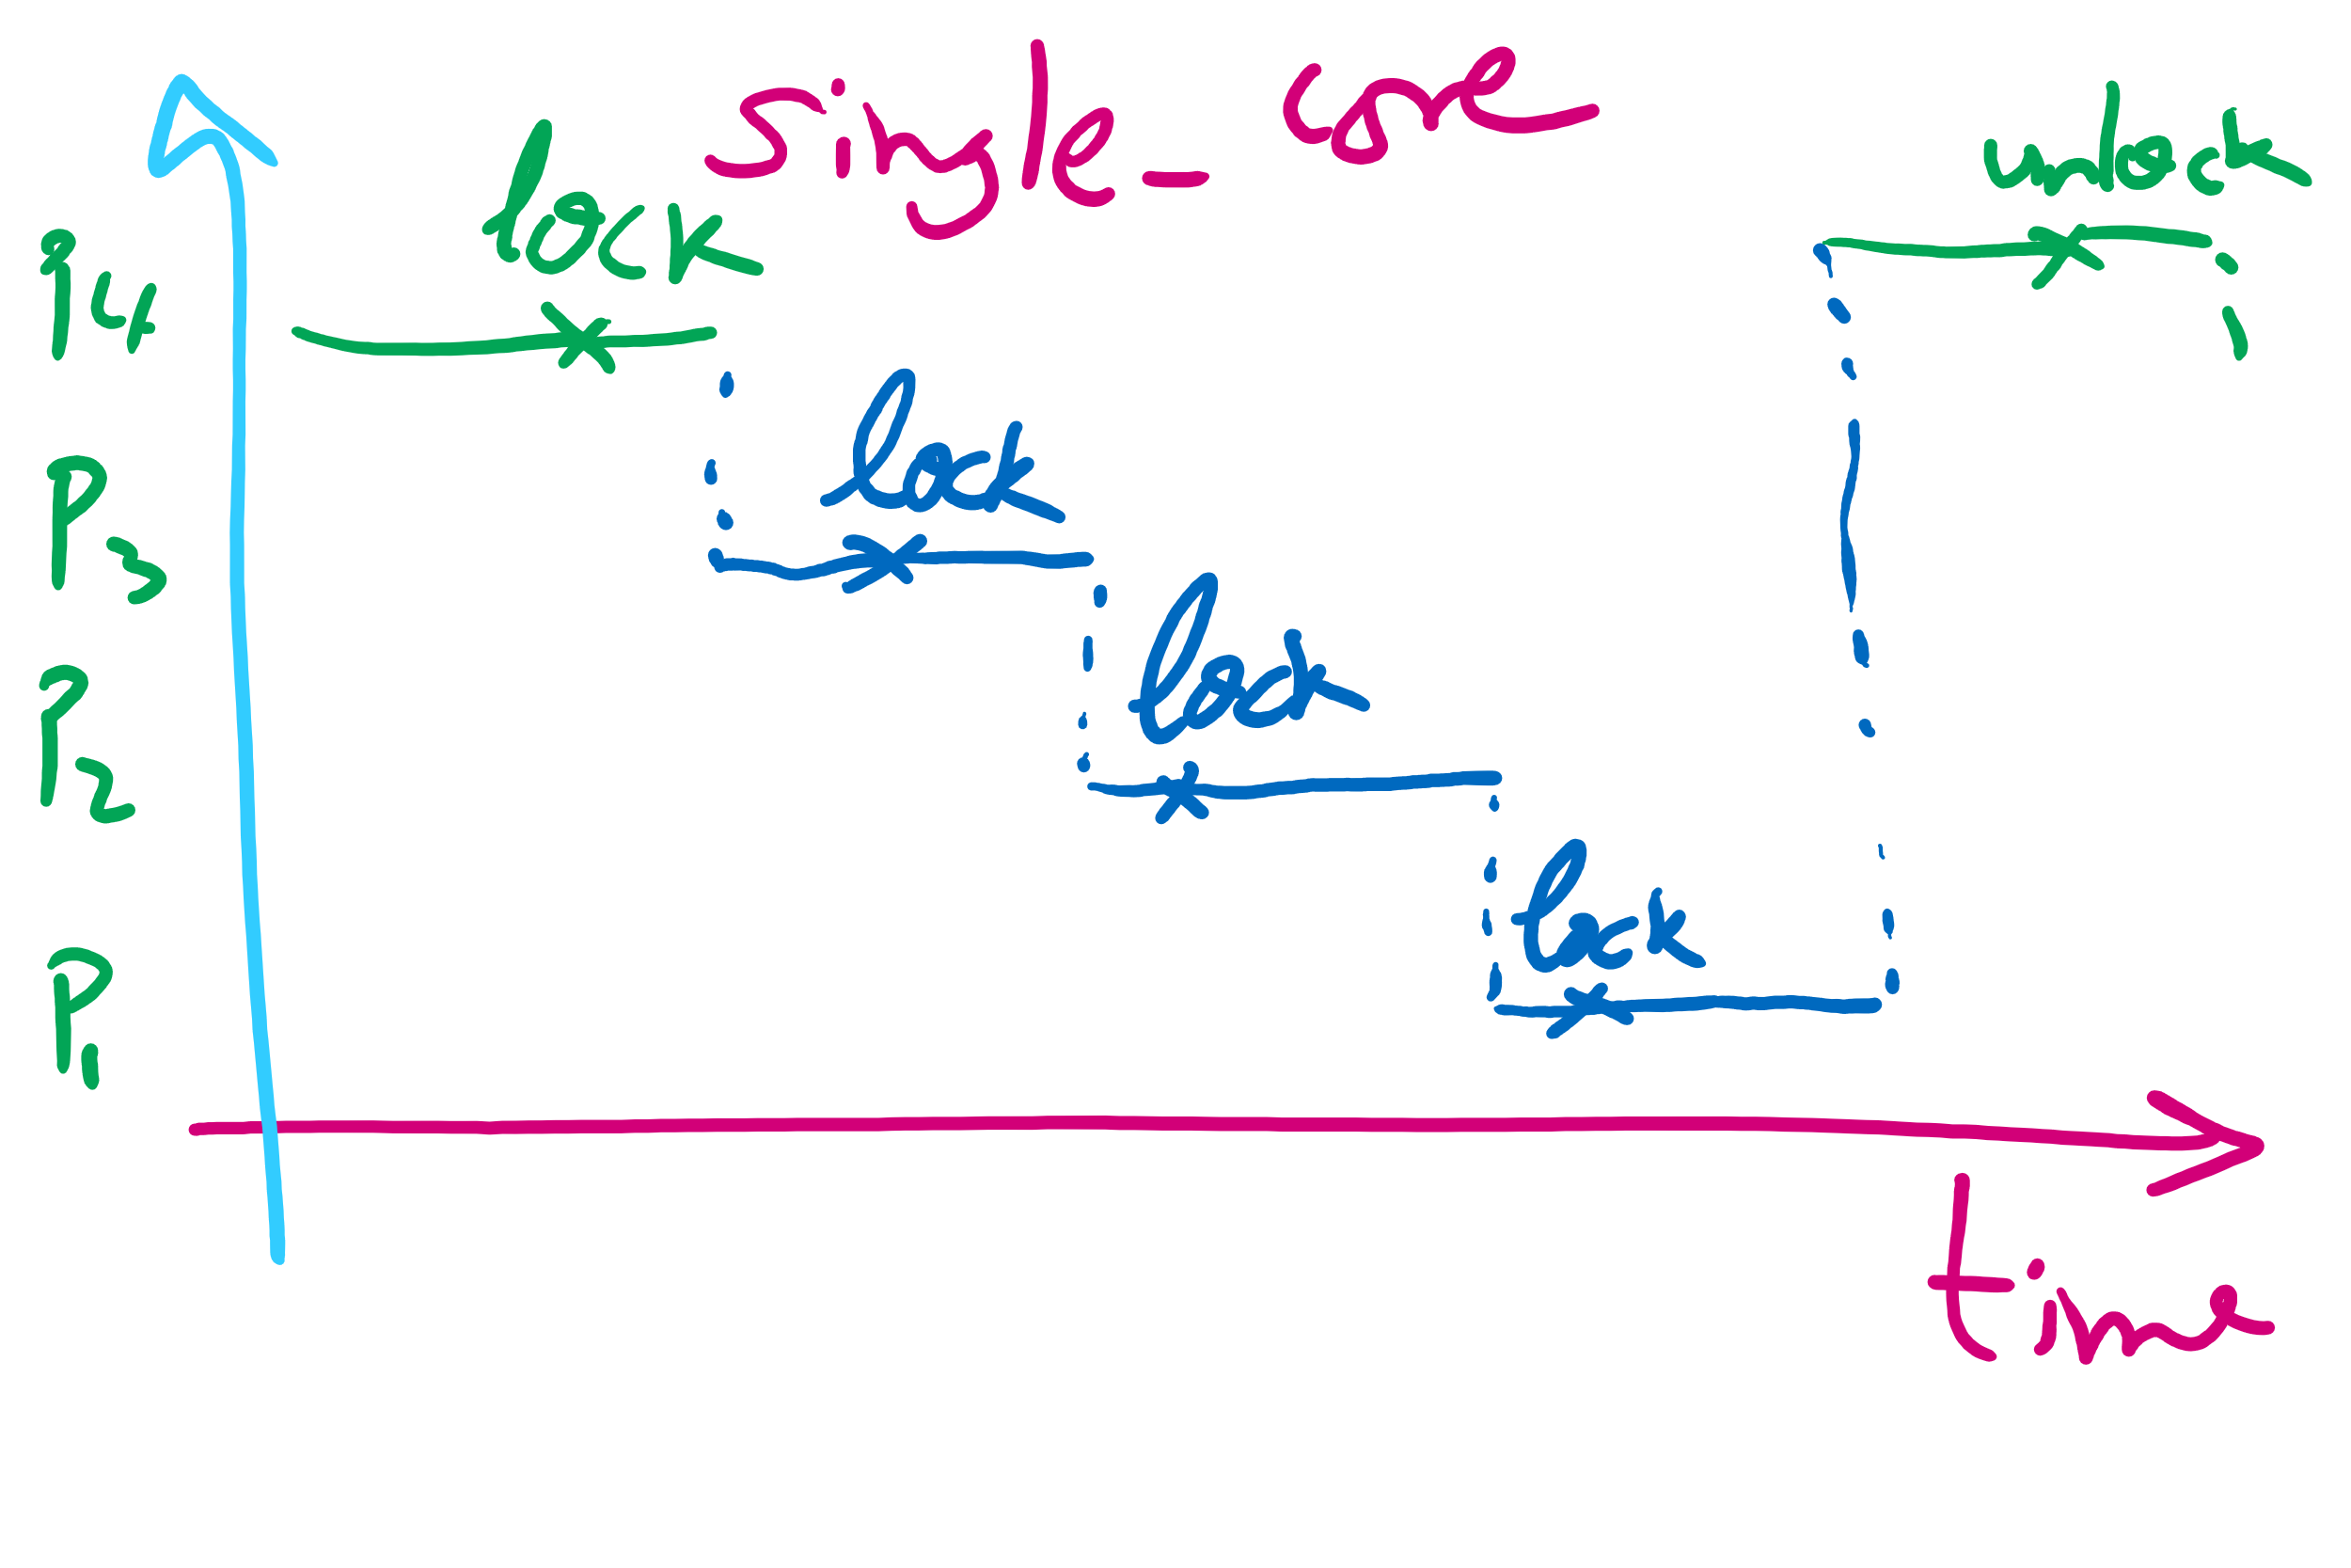
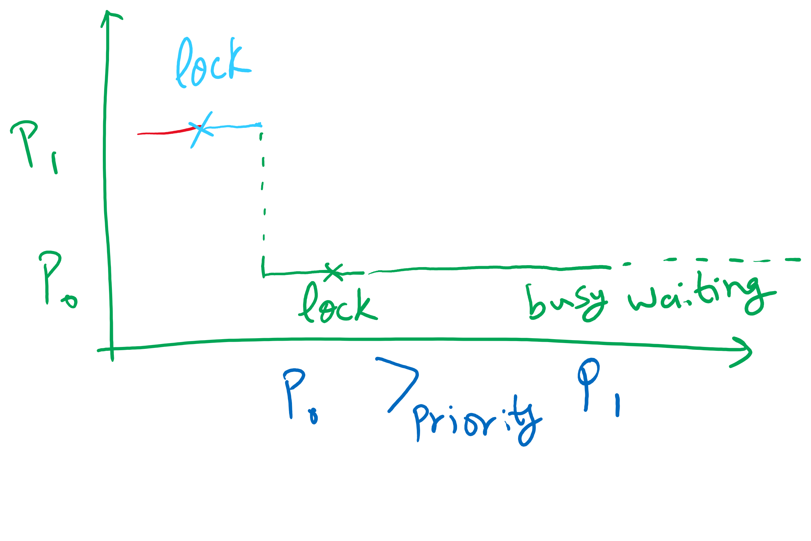
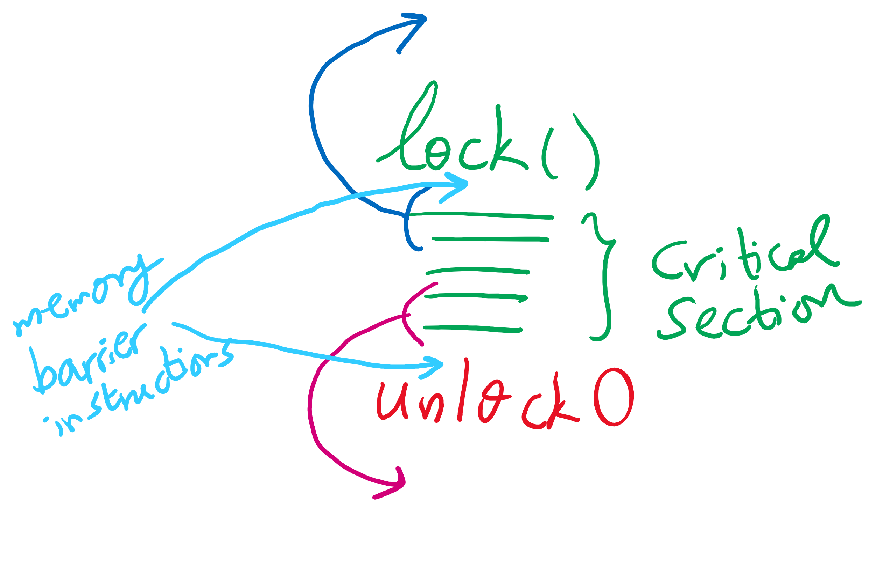


Spinlock Problems
Problem: wastes CPU time
Would be better to allow processes to sleep while they wait to execute their critical sections
Problem: priority inversion (higher priority process waits for lower priority process)
Problem: compiler and/or hardware instruction reordering

Slide 23
Critical sections using semaphores
Define a data structure called Semaphore
Details hidden from processes
Code for individual process is simple
Shared variables
Semaphore sem;
Code for process P_{i}
while (1) {
// non-critical section
down(sem);
// critical section
up(sem);
// non-critical section
}

Slide 24
Semaphores for general synchronization
We want to execute B in P1 only after A executes in P0
Use a semaphore initialized to 0
Use up() to notify P1 at the appropriate time
Shared variables
// flag initialized to 0
Semaphore flag(0);
Process P₀
.
.
.
// Execute code for A
flag.up ();
Process P₁
.
.
.
flag.down ();
// Execute code for B

Slide 25
Types of semaphores
Two different types of semaphores
Counting semaphores
Binary semaphores
Counting semaphore
Value can range over an unrestricted range
Binary semaphore
Only two values possible
1 means the semaphore is available
0 means a process has acquired the semaphore
May be simpler to implement
Possible to implement one type using the other

